Slide 1

VFX Graphics
Guided by
Dr. Priyanka Mehta
Submitted by
Dudam Laxmikant Shankar

Slide 2
AGENDA
Computer Graphics
VFX
Introduction
History of computer graphics
What is computer graphics
Why use computer graphics
Advantages of computer graphics
Disadvantages of computer graphics
Introduction
History Of VFX
What is VFX?
Why use VFX?
VFX Categories
ILM
Software Use VFX
Key differences
Advantages of VFX
Disadvantages of VFX
Conclusion
References

Slide 3

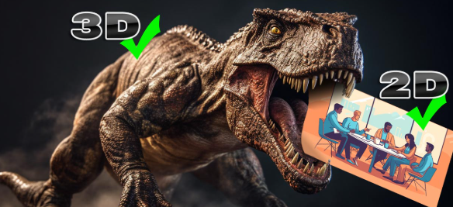

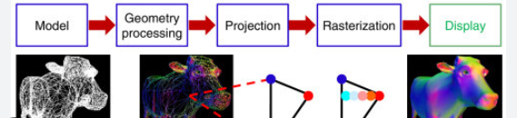
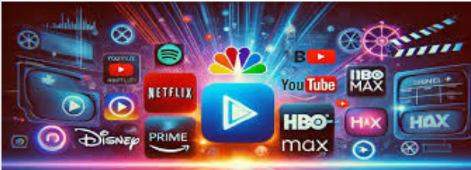
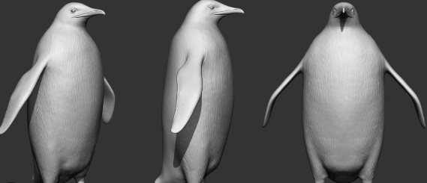

INTRODUCTION
Computer graphics:
Computer graphics refers to the creation, manipulation, and representation of visual images and animations using computers. It involves the use of various hardware and software tools to generate images that can represent objects, scenes, or abstract concepts in two or three dimensions.
Key Elements of Computer Graphics:
2D Graphics
3D Graphics
Rendering
Animation
Applications of Computer Graphics:
Entertainment
Design and Architecture
Advertising and Marketing
Education and Training

Slide 4
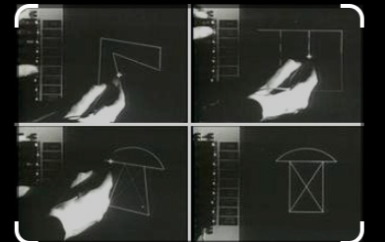
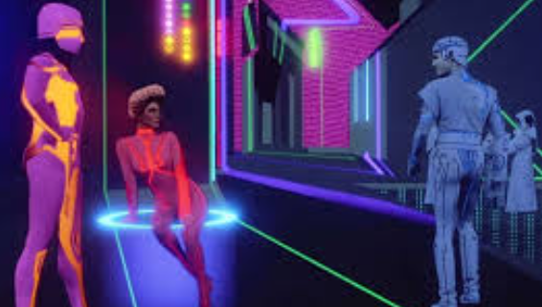
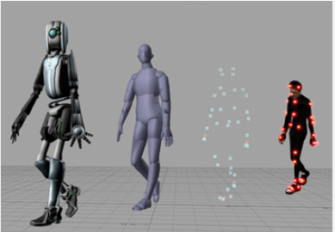
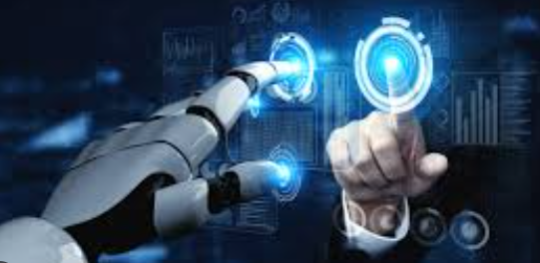
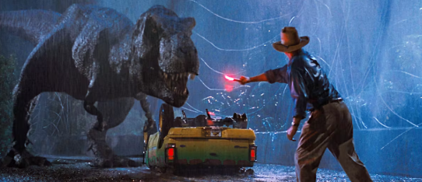
HISTORY
Computer Graphic:
1950s-1960s: Early computer experiments, such as Sketchpad (1963), set the foundation for interactive graphics.
1970s: The development of 3D models and the first uses of CGI in films.
1980s: The rise of 3D animation and the first CGI-heavy films like Tron.
1990s: CGI became mainstream with films like Jurassic Park, and 3D gaming became popular.
2000s-Present: Realistic rendering, VR/AR, and AI-driven tools have revolutionized both entertainment and practical applications of graphics.

Slide 5
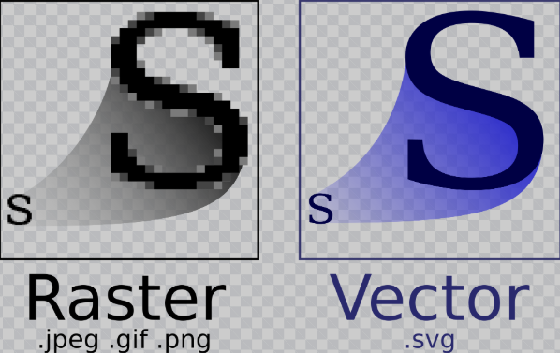
WHAT IS COMPUTER GRAPHICS?
A graphic is a visual image or design that can be created by hand or digitally, and displayed on a screen or printed on a physical medium. Graphics are used to communicate information, convey ideas, or enhance the visual appeal of various forms of media.
Types: 1. Vector Graphics:
o Made up of paths defined by mathematical equations (e.g., lines, curves).
o Scalable without losing quality.
o Examples: Logos, icons, SVG(Scalable Vector Graphics),
VSTM(Visio Macro-Enabled Drawing Template)
2. Raster Graphics :
o Made up of pixels and have a fixed resolution.
o High detail but lose quality when scaled up.
o Examples: Photographs, digital paintings.,
JPEG(Joint Photographic Experts Group),PNG(Portable Network Graphics),GIF(Graphics Interchange Format).
3. Motion Graphics:
o Combine animation and text to convey information dynamically.
o Examples: Title sequences in movies, explainer videos.

Slide 6
WHY USE COMPUTER GRAPHICS?
Simplify Communication:
Visuals make complex ideas easier to understand.
Enhance Appeal:
Graphics improve aesthetics and create a professional appearance.
Support Branding:
Logos, designs, and visuals establish brand identity and boost marketing.
Improve Usability:
Interactive graphics enhance user experience in apps and websites.
Aid Education:
Graphics like charts and simulations make learning engaging and effective.

Slide 7
ADVANTAGES OF COMPUTER GRAPHICS
Easy to edit
mages can be resized without becoming jagged or pixelated, and image file size is small.
Visual appeal
Graphics can make interfaces more visually appealing and improve usability.
Effective communication
Graphics can help convey complex data or concepts in a more understandable manner.
Enhance content
Graphics can enhance the clarity, credibility, and relevance of content by simplifying complex concepts, illustrating processes, and highlighting key points.
Produce animations
Computer graphics can produce moving pictures, which can be used to create animations.
Specialized purposes
Digital graphics can be used for specialized purposes such as motion capture, 3D modeling, virtual reality, and augmented reality technology.

Slide 8
Disadvantages of Computer Graphices
Cost: Computer graphics can be expensive to develop, especially if an organization outsources the work.
Technical limitations: Graphics-intensive applications require powerful computers to run smoothly.
Health risks: Computer graphics can cause eyestrain and other health risks.
Complexity: Complex graphical systems require training or an expert to install and customize.
Lack of intelligence: Graphical systems can't understand real-world conditions or principles.
Performance issues: 2D graphics libraries can affect application performance, especially for complex or dynamic graphics.
Lack of data sets: There is a lack of high-quality and diverse data sets for training, testing, and evaluating algorithms and models.

Slide 9
INTRODUCTION
VFX(Visual Effects):
At its core, VFX stands for Visual Effects, the artful manipulation and augmentation of imagery to create fantastical worlds, breathtaking scenarios, and astonishing phenomena.
Visual effects (VFX) is the process of creating or altering images to create a desired look for live-action media, such as movies, TV shows, and advertisements. VFX artists use a variety of techniques to create imagery that doesn't exist in the real world, or that would be too dangerous, expensive, or impractical to film.
Computer-generated imagery (CGI)
Compositing ➢ Matte painting
Animation ➢ Texture painting
Lighting
FX
Environment
Matchmoving
Types

Slide 10
HISTORY
The Beginnings (Pre-1900s): Visual effects originated with stage illusions and photography, using techniques like multiple exposures, matte paintings, and stop-motion animation, pioneered by Georges Méliès in A Trip to the Moon (1902).
The Silent Film Era (1900–1930s): Techniques like rear projection and forced perspective brought futuristic worlds to life in films like Metropolis (1927). Stop-motion pioneers like Willis O’Brien animated creatures in The Lost World (1925) and King Kong (1933).
Golden Age of Hollywood (1930–1960s): Matte paintings, miniatures, and optical printing enhanced classics like Gone with the Wind (1939) and Ben-Hur (1959).
Modern VFX Rise (1970s–1980s): Films like 2001: A Space Odyssey (1968) and Star Wars (1977) revolutionized VFX with miniatures, motion control, and emerging CGI.
The Digital Revolution (1990s): Full CGI characters emerged in Terminator 2 (1991) and Jurassic Park (1993), blending digital effects with animatronics.
Photorealism in the 21st Century: Films like Avatar (2009) and Marvel blockbusters pushed photorealistic CGI and simulations, supported by motion capture.
Real-Time Rendering: Game engines like Unreal Engine enabled real-time VFX for film, gaming, and virtual production.
Virtual and Augmented Reality: VR and AR expanded the scope of VFX, creating immersive experiences.
AI and Machine Learning: Modern tools optimize tasks like animation, rotoscoping, and texture creation, transforming workflows.
Future Trends: Technologies like LED walls, virtual production, and open-source tools like Blender are democratizing and redefining VFX.

Slide 11
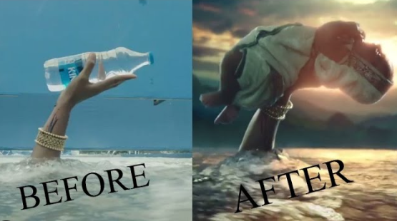
WHAT IS VFX?
VFX (Visual Effects) refers to the process of creating or manipulating imagery in live-action footage using computer-generated elements or other technologies. It is commonly used in films, television, video games, and advertisements to create scenes, environments, or effects that are impractical, expensive, or impossible to capture during live-action filming.
Examples:
Movies
Avatar (2009)
Avengers: Endgame (2019)
TV Shows
Game of Thrones (2011–2019)
Stranger Things (2016–Present)
Video Games
The Last of Us Part II (2020)
Cyberpunk 2077 (2020)
Advertisements
Coca-Cola Commercials
Car Advertisements

Slide 12
WHY USE VFX?
Enhance Visual Storytelling: VFX adds realism, emotion, and creativity to stories, making them more engaging.
Create the Impossible: It allows the depiction of scenes or events that are otherwise impossible or too costly to achieve in reality.
Improve Aesthetics: High-quality VFX adds a polished and professional look to films, games, and advertisements.
Boost Audience Engagement: Stunning visuals captivate viewers, leaving a lasting impression.
Support Digital Innovation: VFX integrates seamlessly with other digital technologies, enhancing experiences in virtual reality, augmented reality, and interactive media.

Slide 13
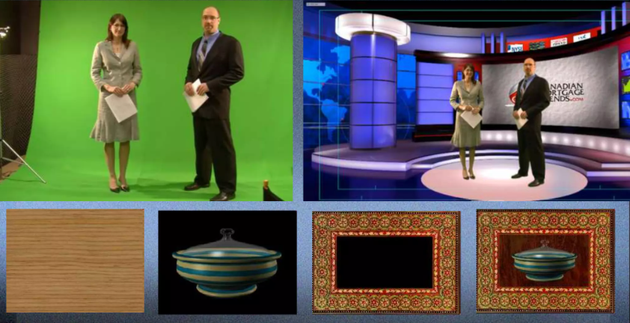
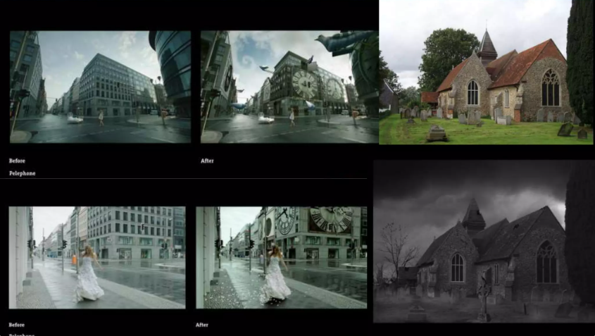
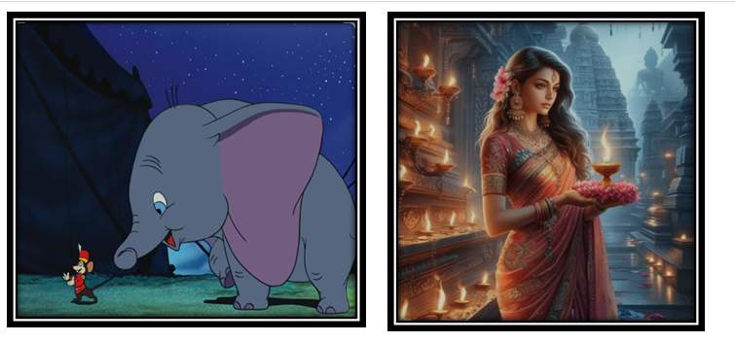
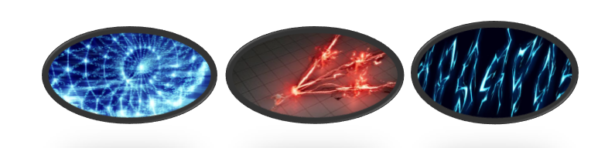
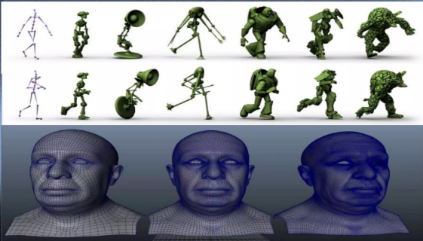
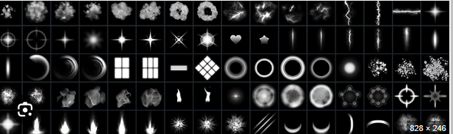
VFX CATEGORIES
Compositing
Matte Painting
Animation
Lighting
Texture
Rigging

Slide 14
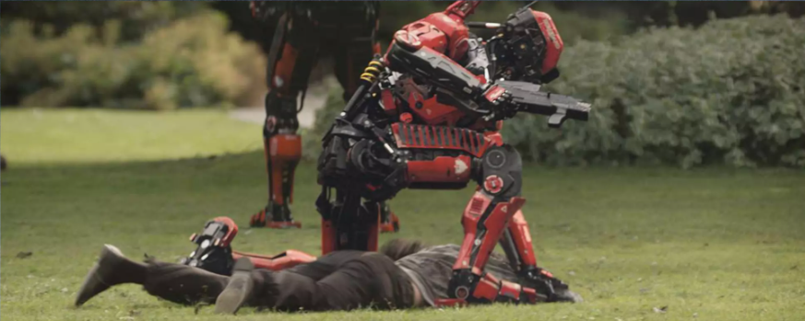

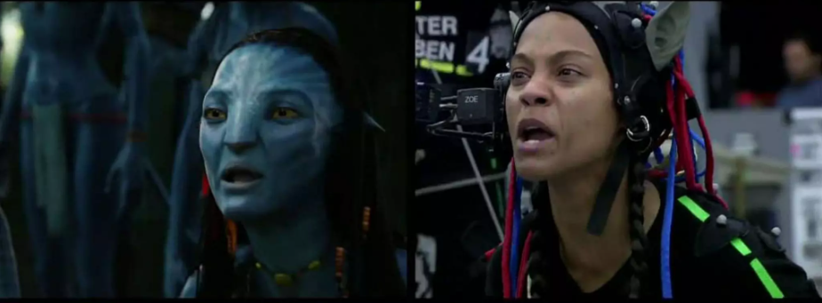
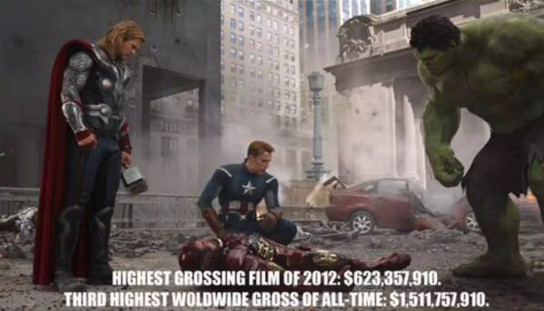
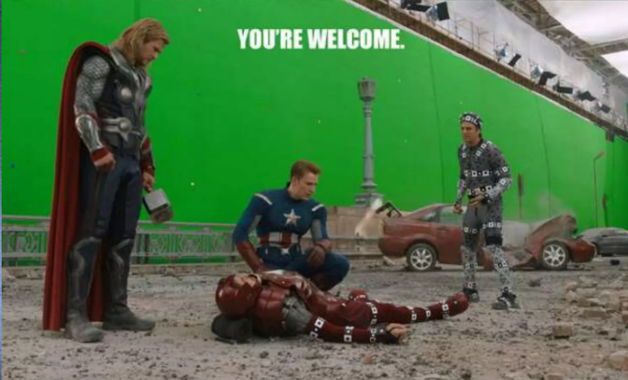
ILM
ILM Stands For Industrial Light & Magic
ILM is a visual effects (VFX) studio that creates iconic moments for film, television and other media.
Before
After
After
Before

Slide 15
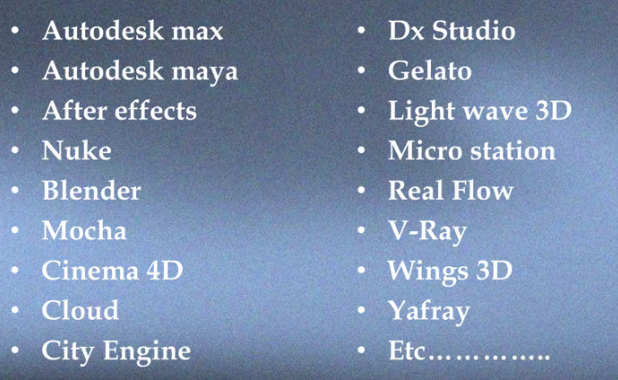
SOFTWARE USED IN VFX

Slide 16
KEY DIFFERENCES
Aspect | Animation | VFX | Graphics
Focus | Creating motion | Enhancing live-action footage | Static or interactive visuals
Use of Live-Action | No | Yes | No
Purpose | Storytelling, entertainment | Realism, immersion | Communication, aesthetics

Slide 17
ADVANTAGES OF VFX
Creative Freedom
Realism in Fantasy
Cost Efficiency
Safety
Time-Saving
Enhanced Storytelling
Increased Audience Engagement
Versatility Across Industries
Adaptability to Technology
Global Appeal

Slide 18
DISADVANTAGES OF VFX
High Costs: VFX software, tools, and specialized talent can significantly increase production expenses.
Time-Consuming: VFX production is complex, with lengthy workflows and long rendering times that can delay projects.
Overuse Can Hurt Storytelling: Excessive VFX can distract from the narrative and reduce emotional depth in a story.
Risk of Uncanny Valley: Poorly executed VFX can lead to unnatural or unsettling visuals, breaking immersion.
Dependence on Technology: Technical failures or rapidly evolving technology can disrupt production and require constant updates.
Time-Consuming:
Complex Workflows: VFX production involves multiple stages, from modeling to rendering, which can significantly delay project timelines.
Rendering Time: High-quality visual effects can take days or weeks to render, depending on complexity.

Slide 19
CONCLUSION
VFX graphics and computer graphics have revolutionized the creative industries by merging technology with imagination, enabling the creation of stunning visuals and immersive experiences.
While VFX focuses on enhancing live-action content with realistic effects, computer graphics generate entirely digital imagery, both playing critical roles in storytelling, design, and entertainment.
Together, they have expanded creative possibilities, from crafting photorealistic characters to designing virtual worlds, transforming how stories are told and experienced. As technology evolves, these fields will continue to push boundaries, shaping the future of visual art and innovation.

Slide 20
REFERENCES
www.youtube.com
www.google.com
www.slideshare.net/slideshow/vfx39060185/39060185
Book:- Computer Graphics

Slide 21


Slide 22


